Slide 1
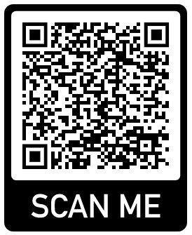
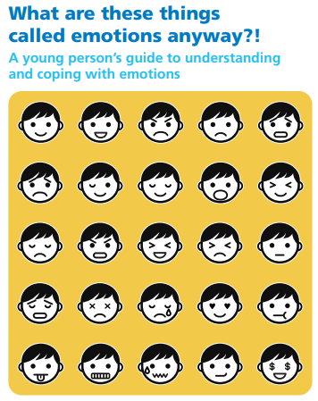
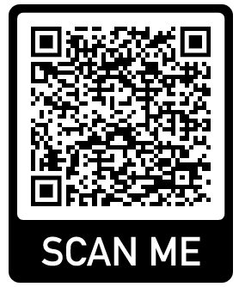
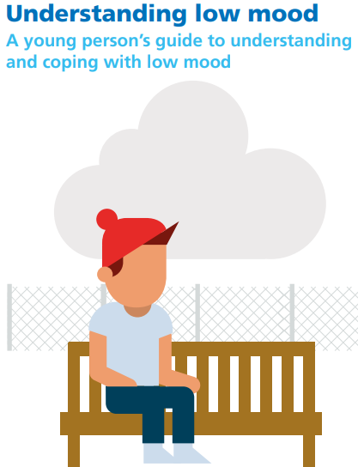
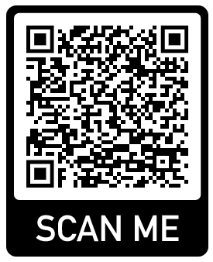
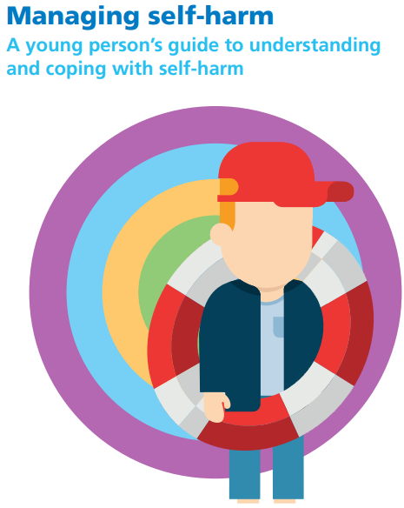
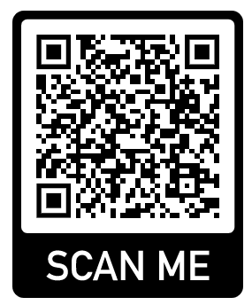
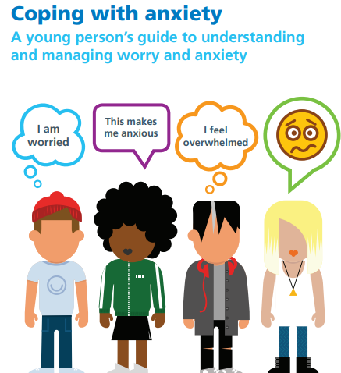
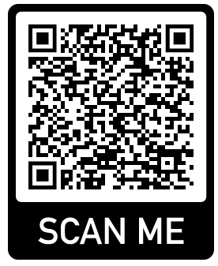
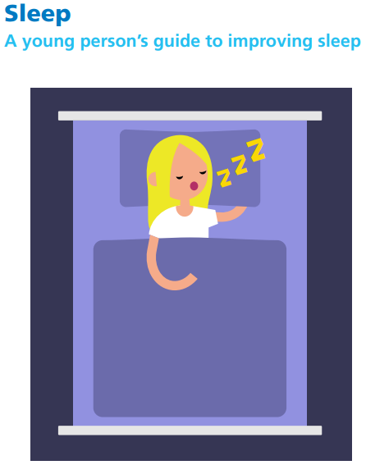
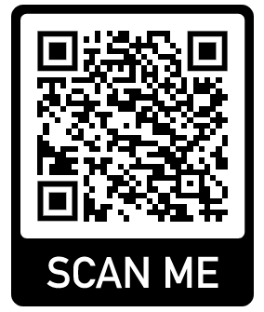
Workbooks
Below are QR codes to access the MindMate Support Team workbooks for children and young people with common mental health difficulties. They are guided self help workbooks that can be delivered independently or with a trusted adult. These workbooks are formed from evidence based practices that the MindMate Support Team work from.
Understanding Emotions
Understanding Low Mood
Managing Self-Harm
Coping with Anxiety
Sleep
This QR code links to our wellbeing journals. They are linked by number to each Key Stage. This also links to guides on how an adult can support a young person with each workbook.

